Slide 1
Association Rule Mining

Slide 2
AR Generation from FIs
So far we have seen algorithms for finding FIs
Lets now look at how we can generate the ARs from FIs
FIs are concerned only with “support”
Time to bring in the concept of “confidence”
For each FI l, generate all non-empty subsets of l
For each non-empty subset s of l, output the rule
s → (l-s) if

Slide 3
AR Generation from FIs
For each k-FI, Y, we can have up to 2^{k}-2 ARs.
Ignore empty antecedents/consequents
Partition Y into 2 non-empty subsets X & Y-X, such that X→Y-X satisfies min_conf
We need not worry about min_sup!
Y={1,2,3}
6 candidate ARs: {1,2} →{3}, {1,3} →{2}, {2,3} →{1},
{1} →{2,3}, {2} →{1,3}, {3} →{1,2}
Do we need any additional scans to find confidence?
For {1,2} →{3}, the confidence is σ({1,2,3})/σ({1,2})
123 is frequent, therefore 12 is also frequent. So no need to find support counts again

Slide 4
Rule Generation
Given a frequent itemset L, find all non-empty subsets f ⊂ L such that f → L – f satisfies the minimum confidence requirement
If {A,B,C,D} is a frequent itemset, candidate rules:
ABC →D, ABD →C, ACD →B, BCD →A, A →BCD, B →ACD, C →ABD, D →ABC AB →CD, AC → BD, AD → BC, BC →AD, BD →AC, CD →AB,
If |L| = k, then there are 2^{k} – 2 candidate association rules (ignoring L → ∅ and ∅ → L)

Slide 5
Rule Generation
How to efficiently generate rules from frequent itemsets?
In general, confidence does not have an anti-monotone property
c(ABC →DE) can be larger or smaller than c(AB →D)
But confidence of rules generated from the same itemset has an anti-monotone property
e.g., L = {A,B,C,D}: c(ABC → D) ≥ c(AB → CD) ≥ c(A → BCD)
Confidence is anti-monotone w.r.t. number of items on the RHS of the rule

Slide 6
Rule Generation for Apriori Algorithm
Low Confidence Rule
Lattice of rules
Pruned Rules

Slide 8
Compact Representation of FIs
Generally, the no. of FIs generated by a tx. DB can be very large
Good if we could identify a small representative set of FIs from which all other FIs could be generated
2 such representations:
Maximal FIs
Closed FIs

Slide 9
Maximal Frequent Itemset
An itemset is maximal frequent if none of its immediate supersets is frequent
Maximal Itemsets
Infrequent Itemsets
Border

Slide 10
Maximal FIs
Maximal FIs are the smallest set of itemsets from which all the FIs can be derived
Maximal FIs do not contain support information of their subsets
An additional scan of the DB is needed to determine the support count of the non-maximal FIs

Slide 11
Closed Itemset
An itemset is closed if none of its immediate supersets has the same support as the itemset

Slide 12
Maximal vs Closed Itemsets
Transaction Ids
Not supported by any transactions

Slide 13
Maximal vs Closed Frequent Itemsets
Minimum support = 2
Closed but not maximal
Closed and maximal
# Closed = 9
# Maximal = 4

Slide 14
Compact Representation of Frequent Itemsets
Some itemsets are redundant because they have identical support as their supersets
Number of frequent itemsets
= 3 * (2¹⁰ -1)
Need a compact representation

Slide 15
Maximal vs Closed Itemsets

Slide 16
Alternative Methods for Frequent Itemset Generation
Traversal of Itemset Lattice
General-to-Specific vs Specific-to-Geneal
Equivalence Classes
Breadth-first vs. Depth-first
Representation of Transaction Data
Horizontal vs. Vertical data layout

Slide 17
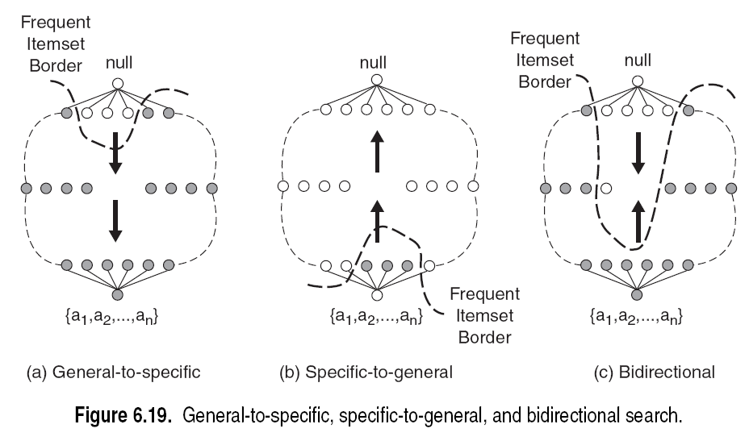

Slide 19
Breadth-first vs. Depth-first

Slide 20
Breadth-first vs. Depth-first

Slide 21
Breadth-first vs. Depth-first
For finding maximal frequent itemsets, which approach you would take?
BFS
DFS
⬅

Slide 22
Breadth-first vs. Depth-first
Quick FI border detection!
Once a maximal FI is found, substantial pruning can be performed on its subsets
bcde is MFI, then we need not visit the subtrees rooted at bd, be, c,d, & e because they will not contain any MFI
If abc is MFI, then only the nodes such as ac & bc are not MFI.
If support for abc is identical to ab, then abd & abe can be skipped because they will not have any MFI

Slide 23
Alternative Methods for Frequent Itemset Generation
Representation of Database
horizontal vs vertical data layout

Slide 24
Variations of the Apriori
Many variations of the Apriori has been proposed that focus on improving the efficiency of the original algorithm
Hash-based technique- hashing itemset counts
Transaction reduction-reducing the number of transactions scanned in future iterations
Partitioning-partitioning the data to find candidate itemsets
Sampling-mining on a subset of the given data
Dynamic itemset counting-adding candidate itemsets at different points during a scan

Slide 25
Q. A database has five transactions. Let min sup = 60% and min conf = 80%.
Find all frequent itemsets using Apriori
List all of the strong association rules

